Slide 1
Agile – Project Planning

Slide 2
Agile Planning Definition
In its simplest form, agile planning is nothing more than measuring the speed a team can turn user stories into working, production-ready software and then using that to figure out when they'll be done. An agile project plan is divided into releases and sprints.
Agile planners define a release, which involves creating a new product or substantially updating an existing product. Each release is broken down into several iterations, also called sprints. Each sprint has a fixed length, typically 1-2 weeks, and the team has a predefined list of work items to work through in each sprint. The work items are called user stories. Planning is based on user stories.
The Release planning phase consists of following items:
Discuss the needed features to address the goals.
Discuss the details involved in each feature, and factors that can influence delivery. This would include the infrastructure required, risk, and external dependencies. Features with highest risk and highest value should be planned early in the release.
Decide how much work you can commit to as a team, to finishing in each sprint. This is usually based on the team’s velocity in previous sprints. You should take into account existing work on infrastructure or tools, and known interruptions such as support work.
List the stories and epics for the release in priority order with their size. An epic is a larger dev task broken down into several user stories.
Add an iteration to the plan.
Add stories to the iteration until it reaches the maximum capacity.
Add more iterations until all user stories are covered, or remove lower priority user stories to adapt to the required time frame for the release.
Share the plan and ask for feedback to get commitment from all team members, product owner and other stakeholders.

Slide 3
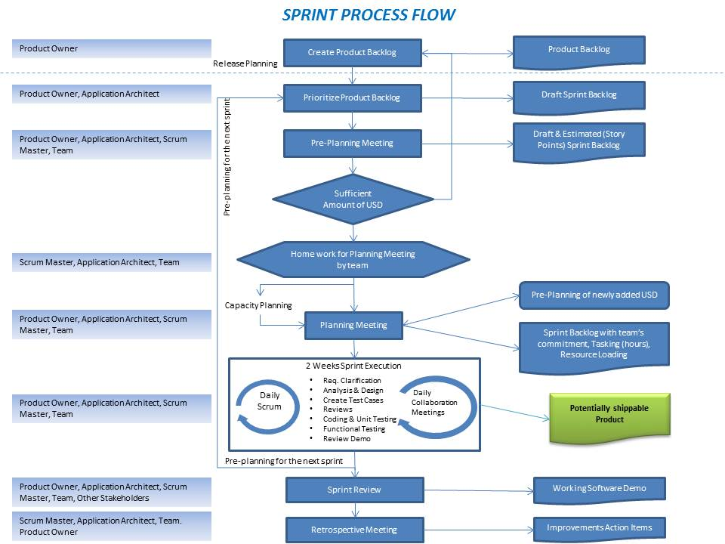
Sprints Process Flow

Slide 4
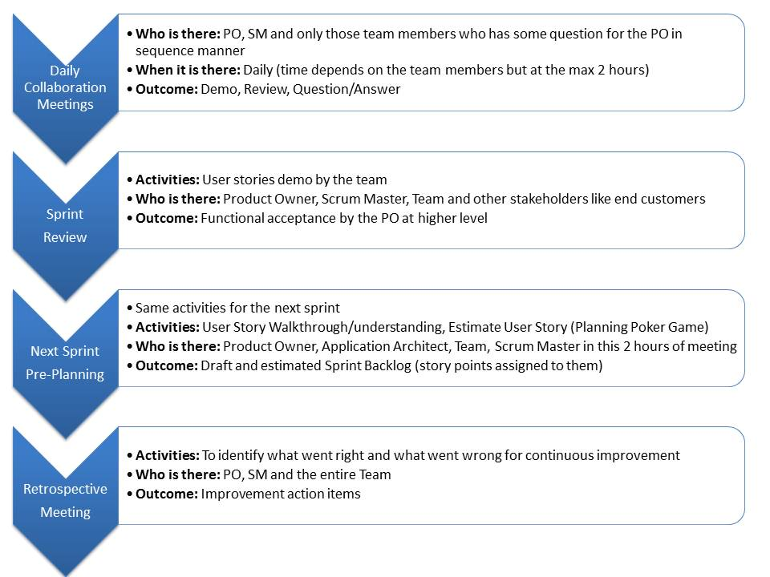
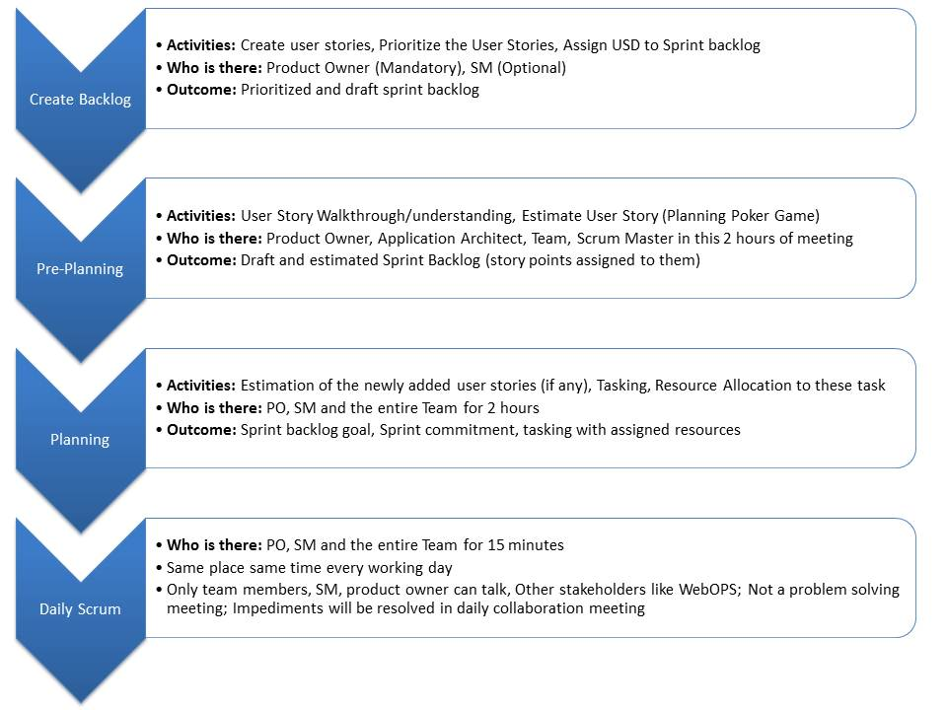
Sprints Process Flow

Slide 5
Level Of Estimation
Project
Activity: High Level Estimate
Who is there:
Release
Sprint
Outcome:

Slide 6
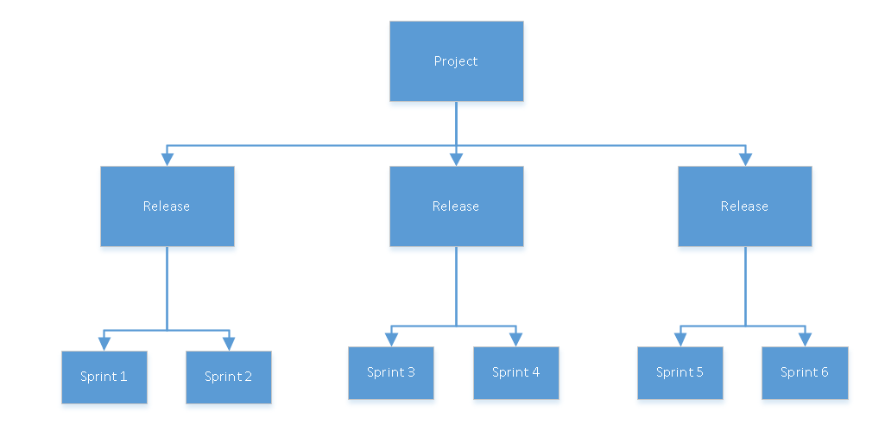
Level Of Estimation

Slide 7
Planning Sprints
Process | Purpose
Sprint 0 Planning | Product owner (PO) will show the release backlog to the project team for the first time. This backlog need not be completed. But at a higher level, product owner should be able to explain his vision about the product to the team. User stories will keep adding into the backlog even at the later stage
Release Planning | Product owner (PO) will show the release backlog to the project team for the first time. This backlog need not be completed. But at a higher level, product owner should be able to explain his vision about the product to the team. User stories will keep adding into the backlog even at the later stage
Pre-Planning Meeting | Pre-planning meeting is to identify the dependencies for the upcoming sprint. If team can resolve the dependencies in coming 3-5 days then these user stories will be part of the sprint backlog otherwise these user stories will be dropped for the coming sprints. Team will discuss the user stories to have an understanding and then estimate the user stories.
Planning Meeting | Planning meeting is the key milestone for the upcoming sprint. If team is able to do the planning effectively and efficiently then sprint will be completed smoothly. But we have a dependency on the functionality and technicality details of the requirements.
Sprint Execution/Daily Work | Details of the daily work is given here. Close tracking of the tasks that are planned in the planning meeting is very important. Daily scrum meetings will give you a chance to talk about the progress and raise your concerns over the roadblocks, dependencies
Sprint Review | This is the last day of the sprint. Team need to give a final demo to the customer of the functionality/features that are just developed in the sprint.
Sprint Retrospective | How to improve on quality, productivity is something discussed in this meeting

Slide 8
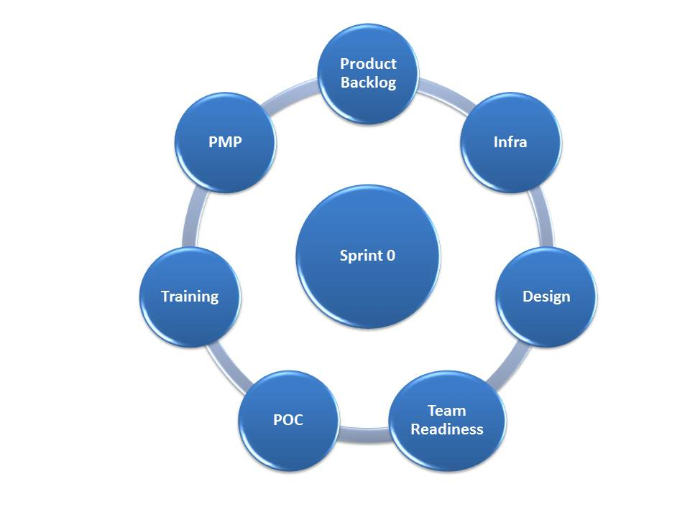
Planning Sprint 0
Sprint Zero is also called as Iteration Zero. Activities listed below will make the team ready for the sprint 1. It is a kind of the preparation for kick off.
Product Backlog/Requirement
Infrastructure readiness
Design/Architecture
Team Readiness
POC
Trainings
Project Management Plan (PMP)
Agile Management Plan: ETVX, Each and every step for implementation; basically an agile Bible
Test Management Plan -Test Strategy, Test Plans, Templates, Performance Testing, Security
Defect Management Plan
Continuous Integration Process
Risk, Assumption, Issues, Dependency (RAID) detailing
Roles & Responsibility of each role like scrum master, project manager, agile coach, delivery manager, developer, QA, sponsor etc
Other Plans

Slide 9
Planning Sprints
First thing before the project kick off is the sprint 0 activities, below activities are during the sprints
Process | Phase | Input(s) | Tools & Techniques | Output(s) | Participants
Release Planning | 5 to -10 days prior to kick off | Product Vision Product Roadmap Prioritized Release Backlog by Product Owner | Agile team will understand the release goal. This is the first time when team will have a look at the release backlog. Before start working on the user stories, team need to understand the key objective behind the release. Understand the business requirements at a higher level. Understanding the core purpose for the project and the release. A prioritized set of user stories that will be developed in the release. A coarse estimate for each story. A date for the release | Draft Release Backlog | Product Owner (Responsible), Agile Team
Pre-Planning Meeting | -5 to -3 days before the sprint start date | Product Owner is ready with prioritized user stories (well above the team’s base velocity) with acceptance criteria All pre-requisite e.g. data model, UI mock up | Sprint Backlog prioritization by product owner User stories walk-through by product owner Technical complexity explanation by application architect Discuss and confirm all pre-requisite e.g. localization requirements, HTML dependency, Webops dependency, database dependency etc. Point sizing of user stories | Draft Sprint Backlog High level point sized user stories Prioritized user stories Inter team dependencies should be agreed upon and time lined | Product Owner and Agile Team
Planning Meeting | Day 1 of the sprint | Product Owner is ready (well above the team’s base velocity) with user stories with acceptance criteria All pre-requisite e.g. data model, UI mock should be available | Kick-off meeting Capacity planning by the scrum master User stories query resolution with product owners, modeling team, UI design etc. User story walk-through by Product owners for newly added user stories Vertical slicing of user stories Determine Sprint defect backlog target Point sizing of newly added user stories and defects Refine Point sizing of user stories due to added complexities/unknowns to data model/UI sc Inter team dependencies should be identified and communicated Task planning, estimation and allocation Agree to sprint commitment | Sprint Backlog with point sized user stories Team’s Capacity Plan Task and related Effort Allocation Team Commitment List of Sprint risks and dependencies All dependent user stories should be moved out of Sprint scope

Slide 10
Planning Sprints (Cont.)
Process | Phase | Input(s) | Tools & Techniques | Output(s)
Sprint Execution/Daily Work | Sprint Execution/Daily Work | Sprint Day 1 committed user stories/Sprint backlog | Scrum Master Daily Scrum meeting Burn-down tracking Roadblock and dependency resolution Risk identification and mitigation plan Team Daily scrum meeting Ongoing/as needed query resolution / discussion with PO and application architect Collaboration meeting with onshore team (technical discussions) Internal user stories demo before PO Acceptance Preparation of acceptance schedule Product owner acceptance demo Development Activities Design discussion & review Heuristic review as soon as UI is done Code development & review JUnit/NUnit tests are written and executed where ever applicable Deployment to QA environment Defect fixing Testing Activities Preparation of acceptance criteria Test case design creation (automation + manual (if needed)) and review Test case execution and automation script review Logging/verify the functional defects into the agile project management tool. | Scrum Master Daily Status to Meta scrum master Risk & Issues or any roadblock Team Daily scrum meetings Design Document Shippable code Unit test cases (If applicable) Test Design document Automation script or Manual Testing result for all the applicable user stories as per the PO acceptance scenario Acceptance Demo to PO as soon as User Story is complete

Slide 11
Planning Sprints (Cont.)
Process | Phase | Input(s) | Tools & Techniques | Output(s)
Sprint Review | Last day of the sprint | Completed Sprint Accepted user stories | Provide demo to Product Owner and other stakeholders PO to share any feedback. Prioritized defect fixes will happen based on the timeline available in current sprint, if not consider for next sprint /moves to product backlog. Review the accomplishments Track all requirements completeness Traceability matrix | Demo output Updated Requirements Traceability matrix
Sprint Retrospective | Last day of the sprint OR 1st week of the next sprint | Completed / to be completed Sprint | Conduct retrospective meeting with team with focus on “What went well”, “What did not go well” & “Action plan for improvements” Prepare action plan for improvement areas Identify any spike and learning opportunity Knowledge sharing across scrum teams | Retro Notes Improvement Plan

Slide 12
Acronyms
Abbreviations | Description
POC | Proof Of Concept
ETVX | Entry Task Verification Exit
PO | Product Owner
SM | Scrum Master
USD | User Story Definition

